Slide 1
Boosting Algorithm in Machine Learning

Slide 2
Boosting – It is defined as ‘encouraging or assisting something in improving.’ There are 3 primary types of Machine Learning augmentation algorithms

Slide 3
1.Adaptive Boosting (also known as AdaBoosta) 2.Gradient Boosting 3.XGBoost

Slide 4
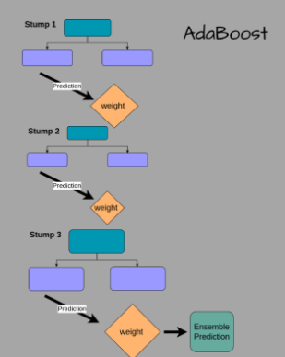
ADA BOOSTING
AdaBoost algorithm, short for Adaptive Boosting, is a Boosting technique used as an Ensemble Method in Machine Learning. It is called Adaptive Boosting as the weights are re-assigned to each instance, with higher weights assigned to incorrectly classified instances.

Slide 5
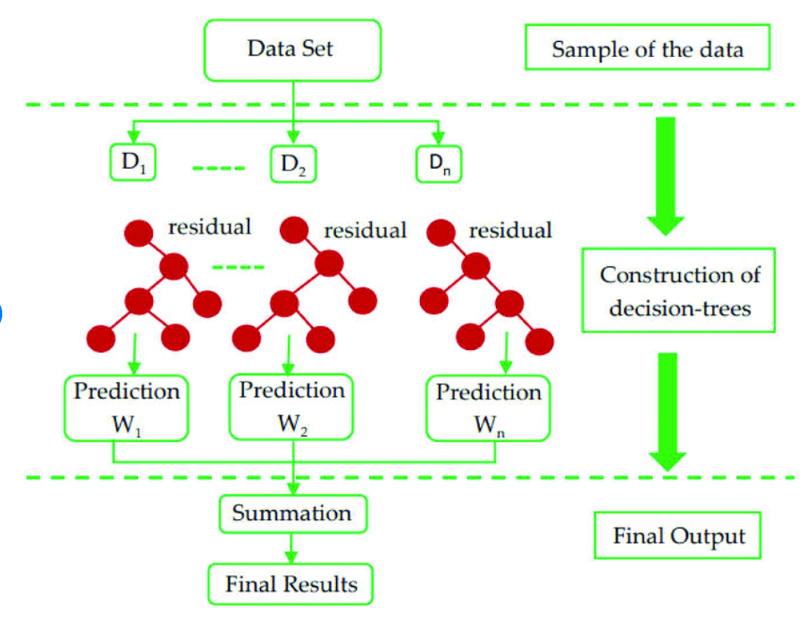
XG BOOSTING
XG Boost algorithm, stands for Extreme Gradient Boosting. This algorithm is an improved version of the Gradient Boosting Algorithm. It is used for supervised learning problems. and which has to be assigned the equal weights and find the residuals from the dataset.

Slide 6
Optimization and Improvement in XG Boosting
Regularization
Parallelization and Cache block
Tree Pruning
Cache-Awareness and Out-of-score computation
Sparsity Awareness
Weighted Quantile Sketch
Cross-validation

Slide 7
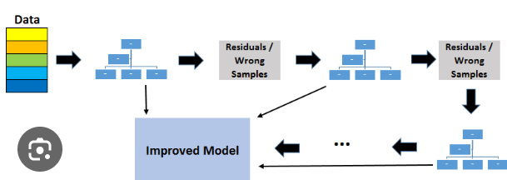
LGBM BOOSTING
LG algorithm, ‘Light Gradient Boosting Machine’, is an open source, high-performance gradient boosting framework designed for efficient and scalable machine learning tasks. It is specially tailored for speed and accuracy, making it a popular choice for both structured and unstructured data in diverse domains.

Slide 8
Key Features of LightGBM
Leaf-wise Tree Growth: Unlike other algorithms that grow trees level-wise, LightGBM grows trees leaf-wise, which can lead to better accuracy.
Gradient-Based One-Side Sampling (GOSS): This technique retains instances with large gradients and randomly drops those with small gradients, optimizing memory usage and training time.
Exclusive Features Bunding(EFB): EFB reduces the numbers of efficient features by bunding nearly exclusive features, improving efficiency, while maintaining accuracy.
Histogram-based Decision Tree Learning: This method is more efficient in terms of both speed memory consumption compared to traditional sorted- based algorithm.

